Slide 1

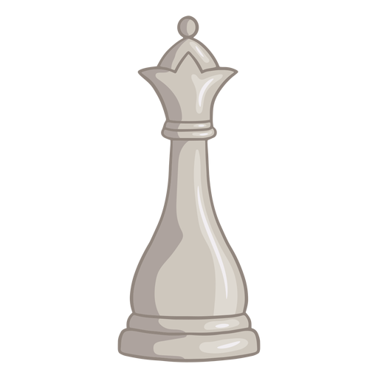
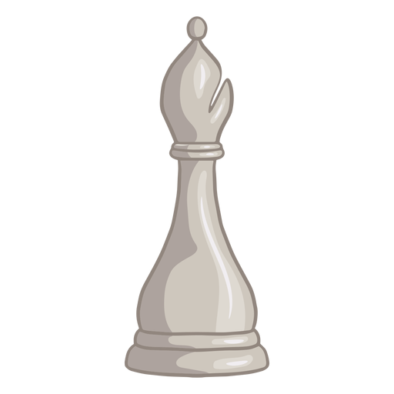
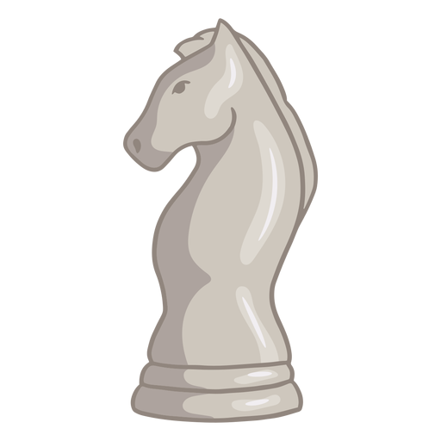
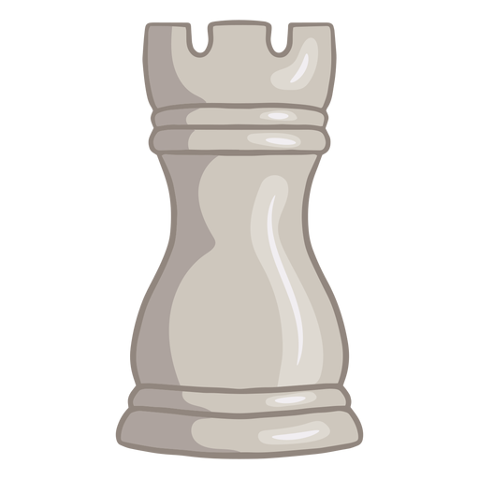
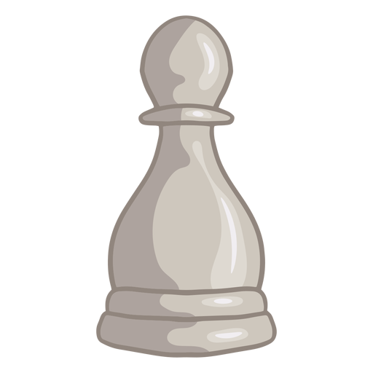
Successful Board Game Design Analysis and Recommendation System
Group 1:
Kai Chuen Tan
Joshua Smith
Xiaolei Du
Ali Zaidi
Siddhant Saoji
Manas Bedmutha
Notes:
Hello and welcome, professor, TAs, and future engineers.
My name is Kai. On behalf of Team 1, I’m honor to present an interesting topic entitled the successful board game design analysis and board game design recommendation system. (13.71 seconds)

Slide 2
Overview
01
02
Motivation and Objective
Methodology
03
04
Dataset and Visualizations
Recommendation System
Notes:
Here’s a quick overview of the presentation. Today, I’ll walk through the motivation and objectives of this project, methodology and present some fascinating data visualization.
Then, the AI engineer in Team 1, Ali will present his work on the recommendation system. (16.01 seconds)
Total: 29.72 seconds

Slide 3
Motivation
Board games have reportedly increased in popularity
How to design a successful board game for the contemporary market
Notes:
In this day and age, board game are reportedly increasing in popularity as a way to have in person interaction due to the increased in digital interactions.
Hence, Team 1 is eager to find out if there are any design trends in board games, and if we can use this data to design a successful board game around these trends. (18.73 seconds)
Total: 48.45 seconds

Slide 4
Objectives
Based on datasets, understand the characteristics of successful board games.
Use this data to build a recommendation design based system to match these trends.
Notes:
In this project, Team 1 aims to analyze data from our data set to determine what makes a board game successful.
With this information, Team 1 can make a recommendation system for board game designers to strategize its board game design features to match these design trends. (16.12 seconds)
Total: 1 minute and 7.18 seconds

Slide 5





Methodology
Data Collection
Data Pre-processing
Data Visualization
Recommendation System
Notes:
To complete this project, Team 1 collected most of the data from Kaggle’s BoardGameGeek Database. Then, we pre-processed the raw data to remove irrelevant features. With the pre-processed data, Team 1 performs data visualization to study how each board game design element correlates with the average user ratings and then, build a board game design recommendation system for board game creators. (23.91 seconds)
Total: 1 minute and 31.09 seconds

Slide 6
Dataset and Data Visualization
Notes:
Now, let us move on to the Dataset and Data Visualization. (3.96 seconds)
Total: 1 minute and 35.05 seconds

Slide 7
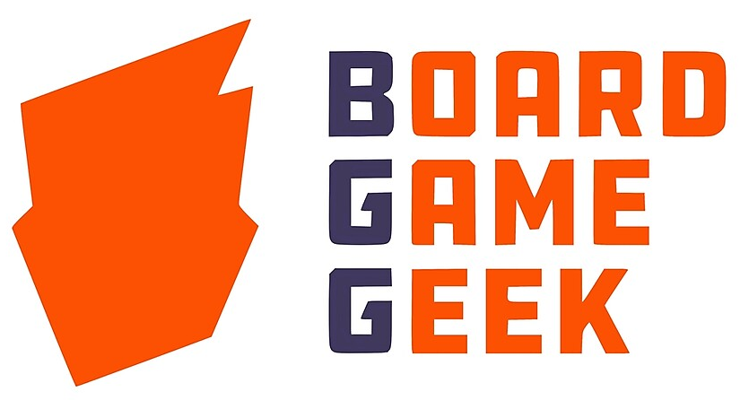
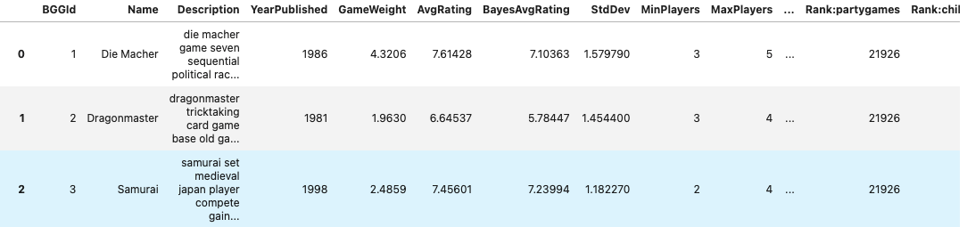
Data Set
2021 Board Games Data-set from the BoardGameGeek
20343 different board games, and 13 design features of each game
Over 47 data points per games including user rating, ownership
Notes:
The latest 2021 board game data-set we have is base on over 20,000 games. These games were pick due to being ranked, which means that each game in the data set has at least 30 user reviews.
Each game has over 47 attributes that can be analyzed.
Some attributes that are key to determine level of customer engagement are the number of ownership, number of people wants the game, and average user rating. (25.42 seconds)
Total: 2 minute and 0.47 seconds

Slide 8
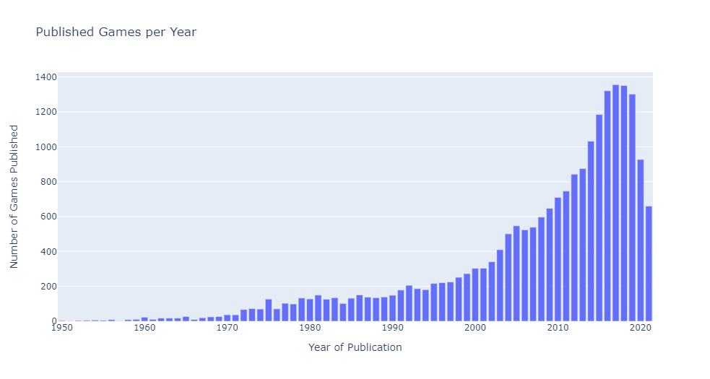
Major Raise in Publishment Starting in 2000s
Notes:
First, we looked at the trend of number of games being published per year to verify this is a market worth invest resource into. We can see that there is a rapid growth in the 2000s.
This era (clicked) is known as the golden age of board gaming.
The rise of the internet gave access to other cultures games, especially Germany because Germany games have distinct mechanics that are less direct conflict and luck.
We also see that there’s a steep decline (clicked) after the year 2020. This is likely due to COVID that prevents meetup and causing less demand for sales. (32.28 seconds)
Total: 2 minute and 32.75 seconds

Slide 9
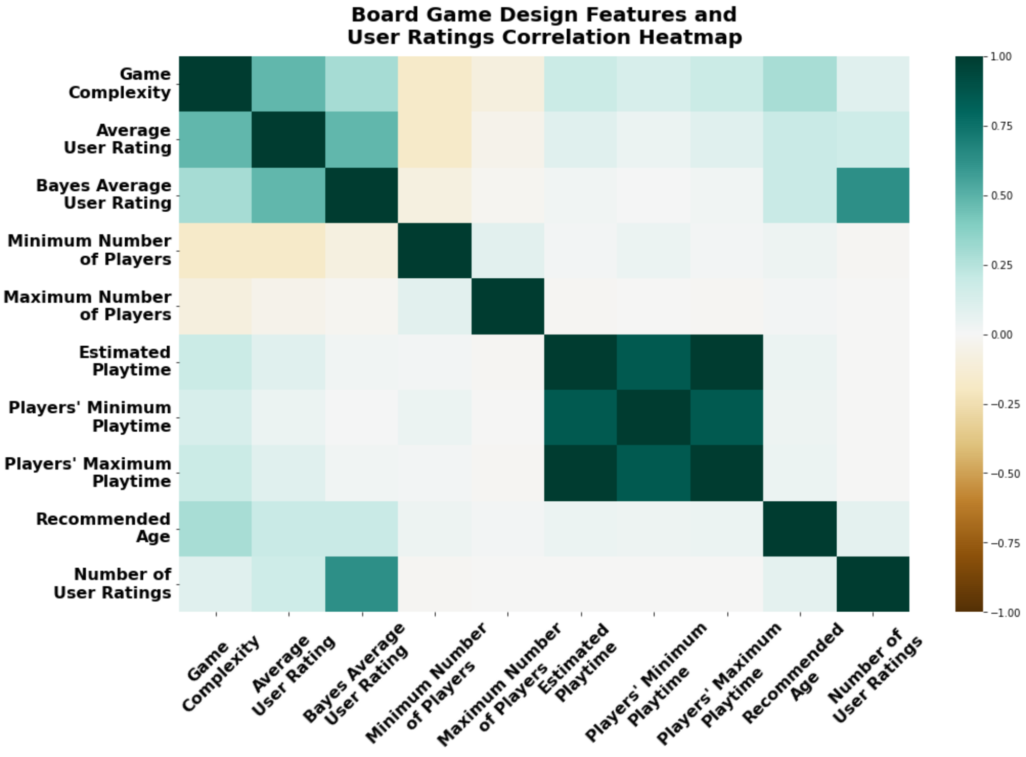
Board Game Design Elements and User Ratings Correlation
Board Game Complexity has the highest positive correlation with the Average User Rating. (i.e., 0.48).
Minimum Number of Players has the lowest negative correlation with the Average User Rating (i.e., -0.17).
Notes:
Team 1 also plotted a correlation heatmap to determine the correlation between each board game design element (clicked) and the average user ratings.
Interestingly, we found that the game complexity (clicked) has a great positive correlation with the average user rating, which means that as the difficulty of a board game increases, the better the average user rating of a board game.
On the other hand, both the minimum and maximum numbers of players design features (clicked) have a negative correlation with the average user rating.
Hence, it shows that adding more players to a board game decreases players’ engagement in the game. (33.56 seconds)
Total: 3 minute and 6.31 seconds

Slide 10
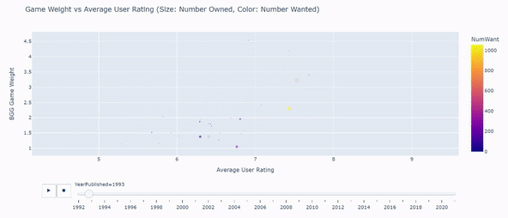
Trend since 1992 show increased complexity leads to higher user rating and desire of ownership
Trend of Since 1992 show increased complexity leads to higher user rating and desire of ownership
Notes:
This animated scatter plot shows an overall trend that more complex games have better average user ratings and greater popularity or number of desire ownerships over the last 30 years.
Hence, it validates the positive correlation between a board game complexity and average user rating from the previous heatmap. (19.10 seconds)
Total: 3 minute and 25.41 seconds

Slide 11
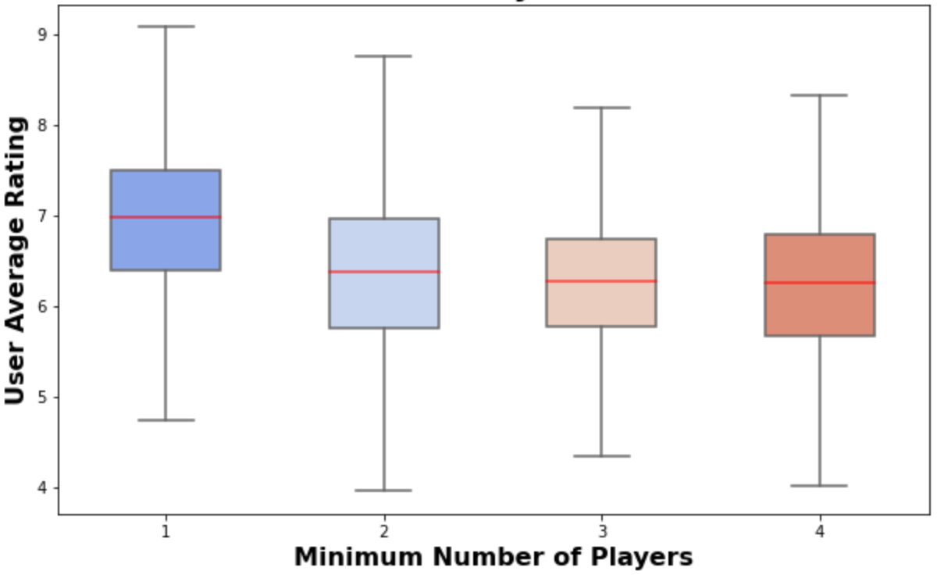
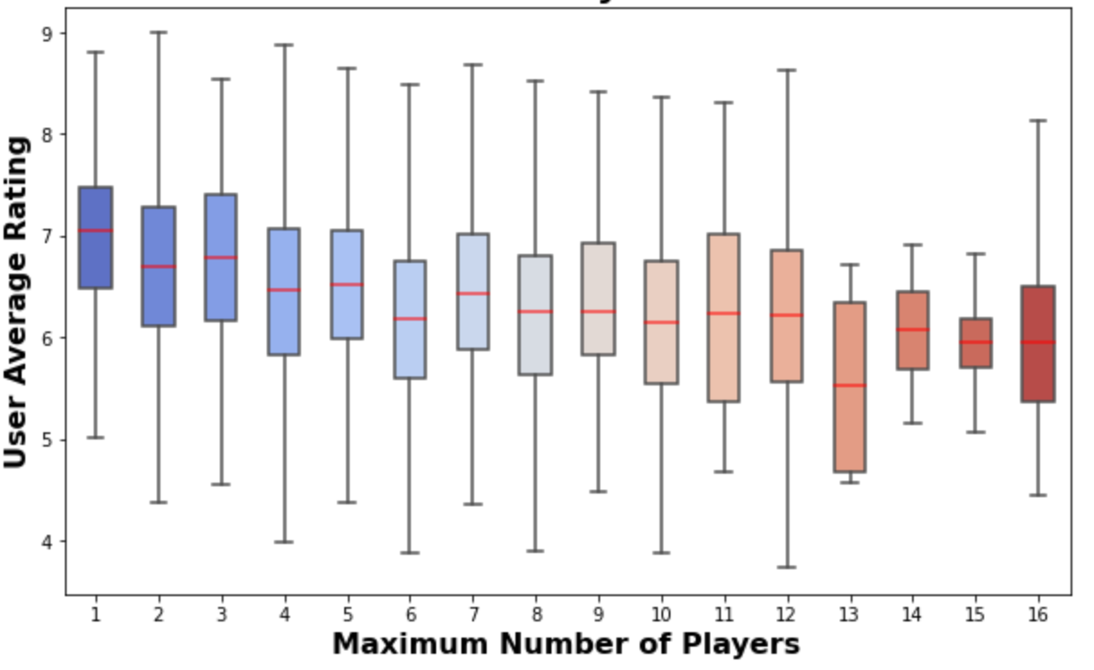
Effects of Minimum and Maximum Number of Players on the Average User Rating
Median of the average user rating steadily declines as the minimum and maximum numbers of players increases.
Notes:
The boxplots above illustrates the effects of the number of board game participants on the average user rating.
As expected from the previous correlation heatmap and boxplots above, the median of the average user rating (clicked) steadily declines as the number of board game participants increases since both the minimum and maximum numbers of players board game design features have a negative correlation with the average user rating. (25.02 seconds)
Total: 3 minute and 50.02 seconds

Slide 12

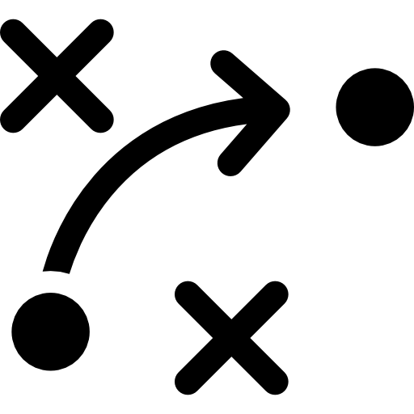


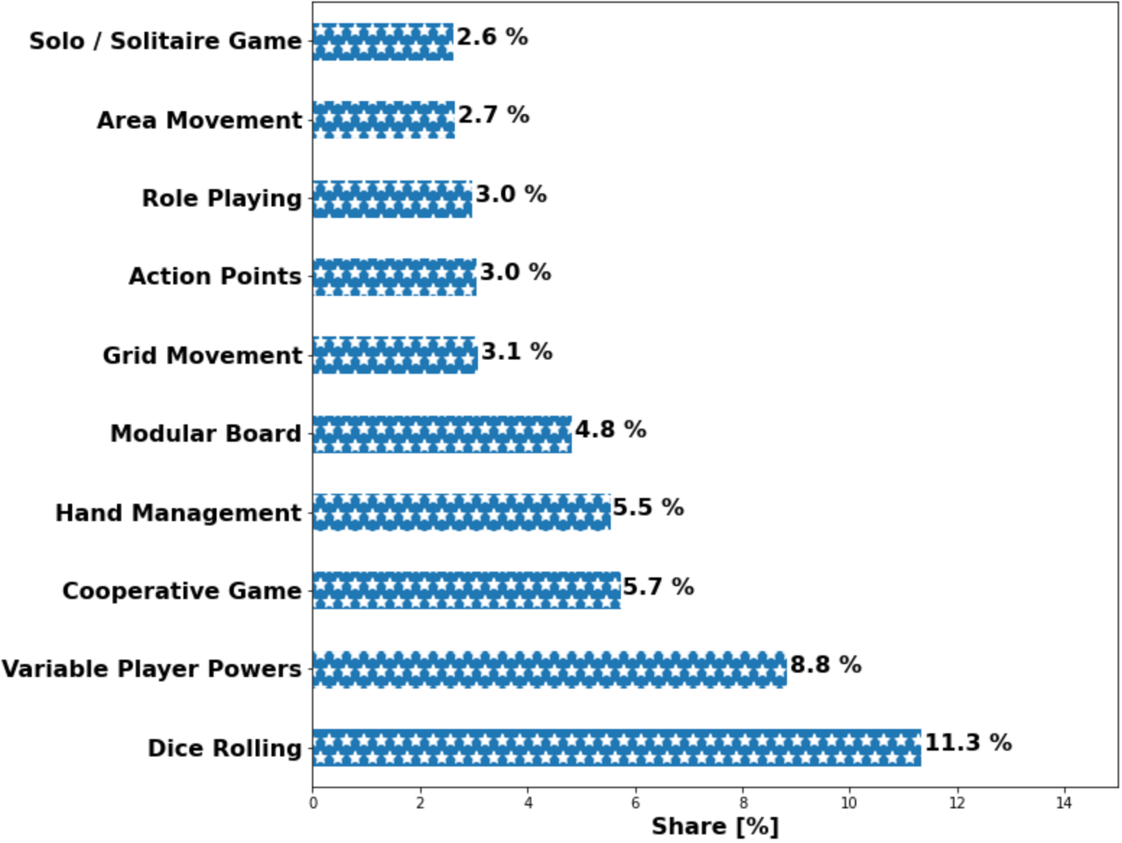
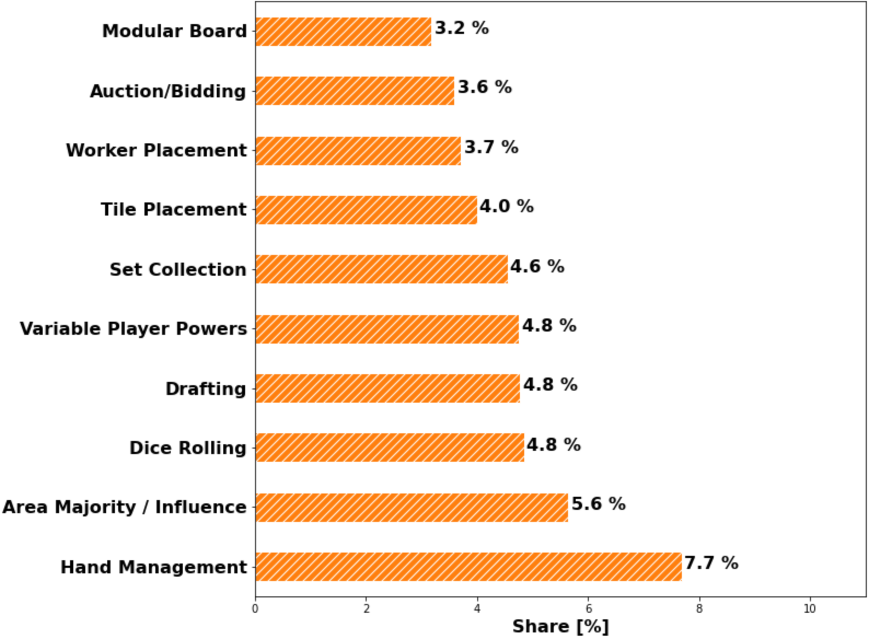
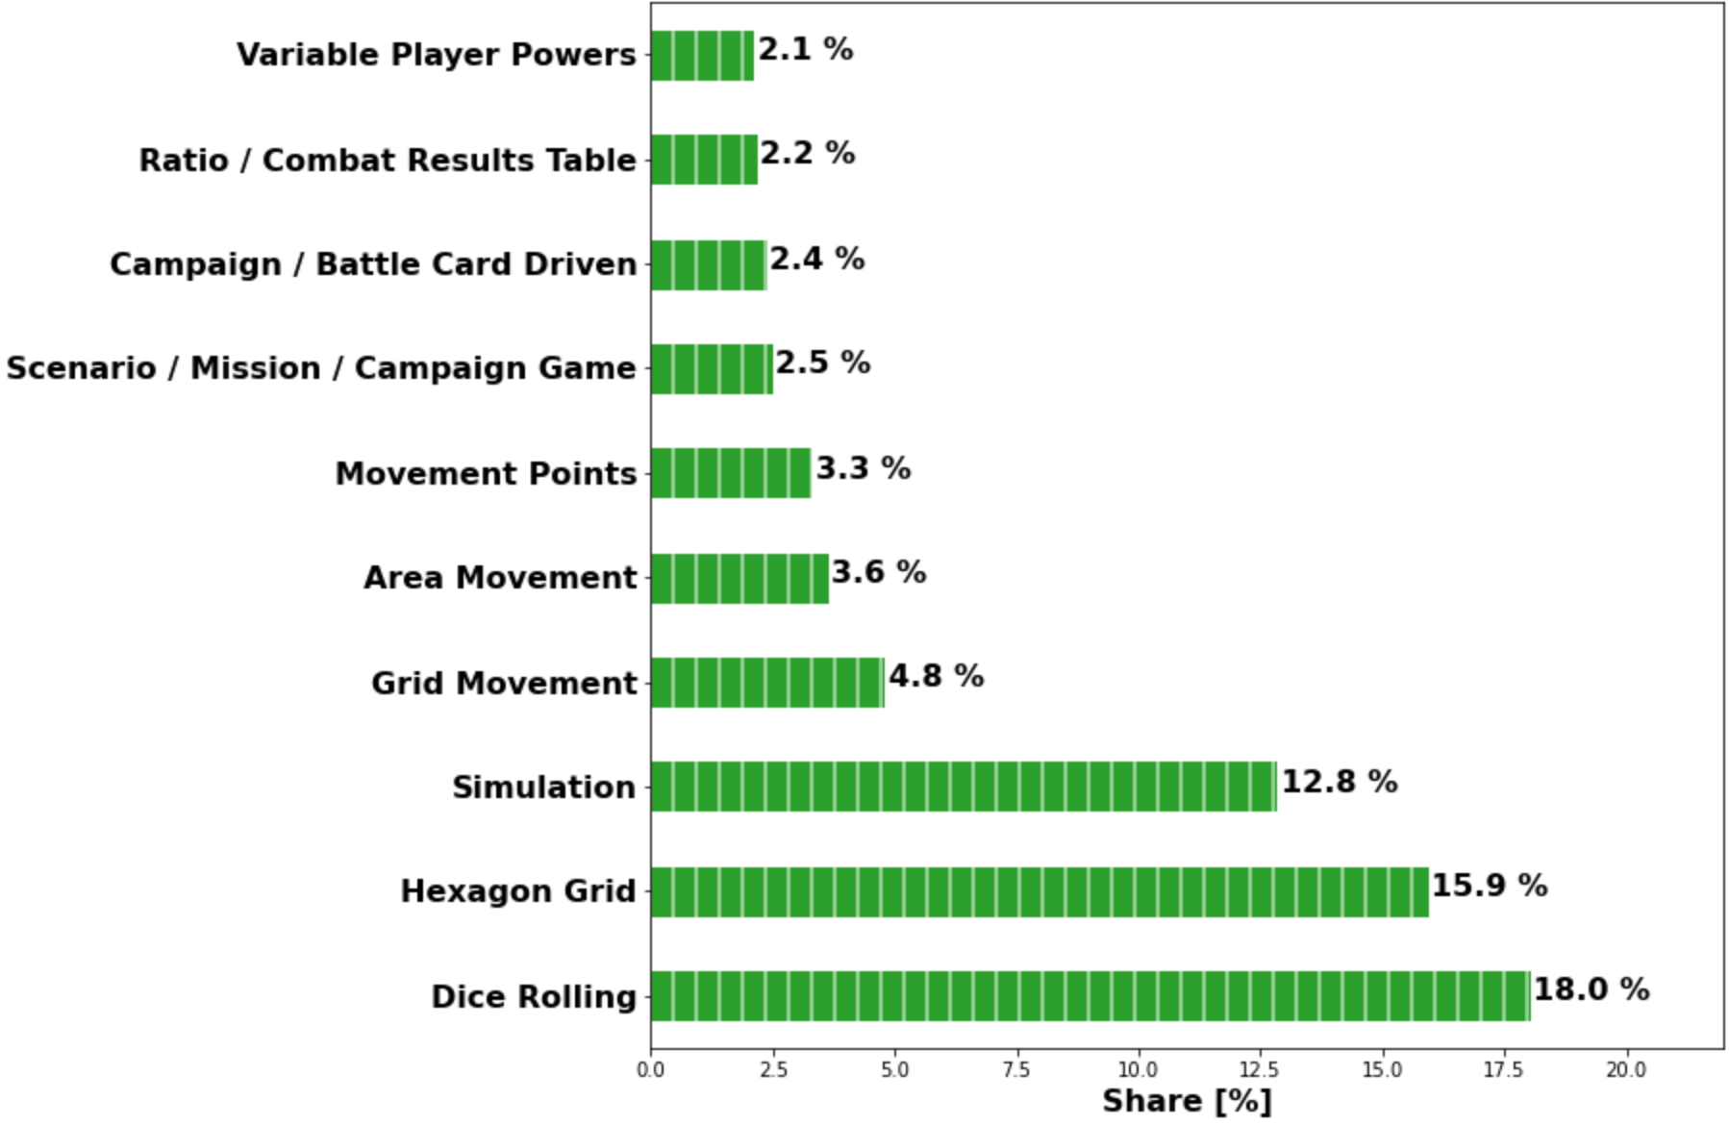
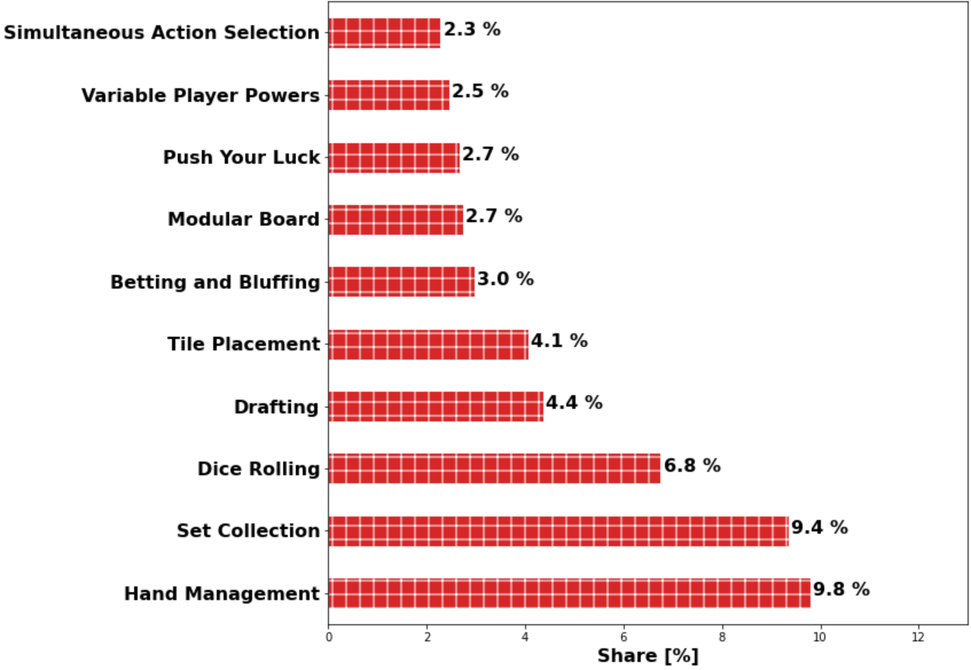
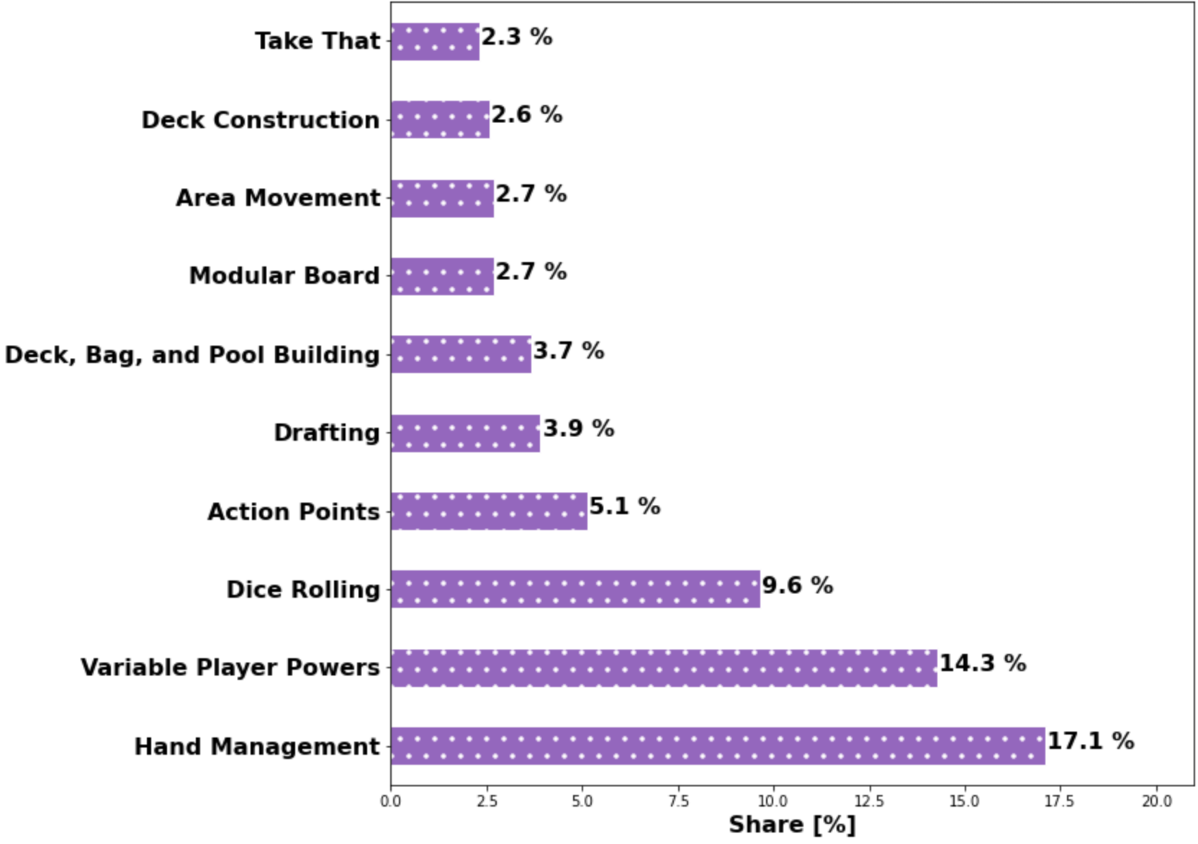
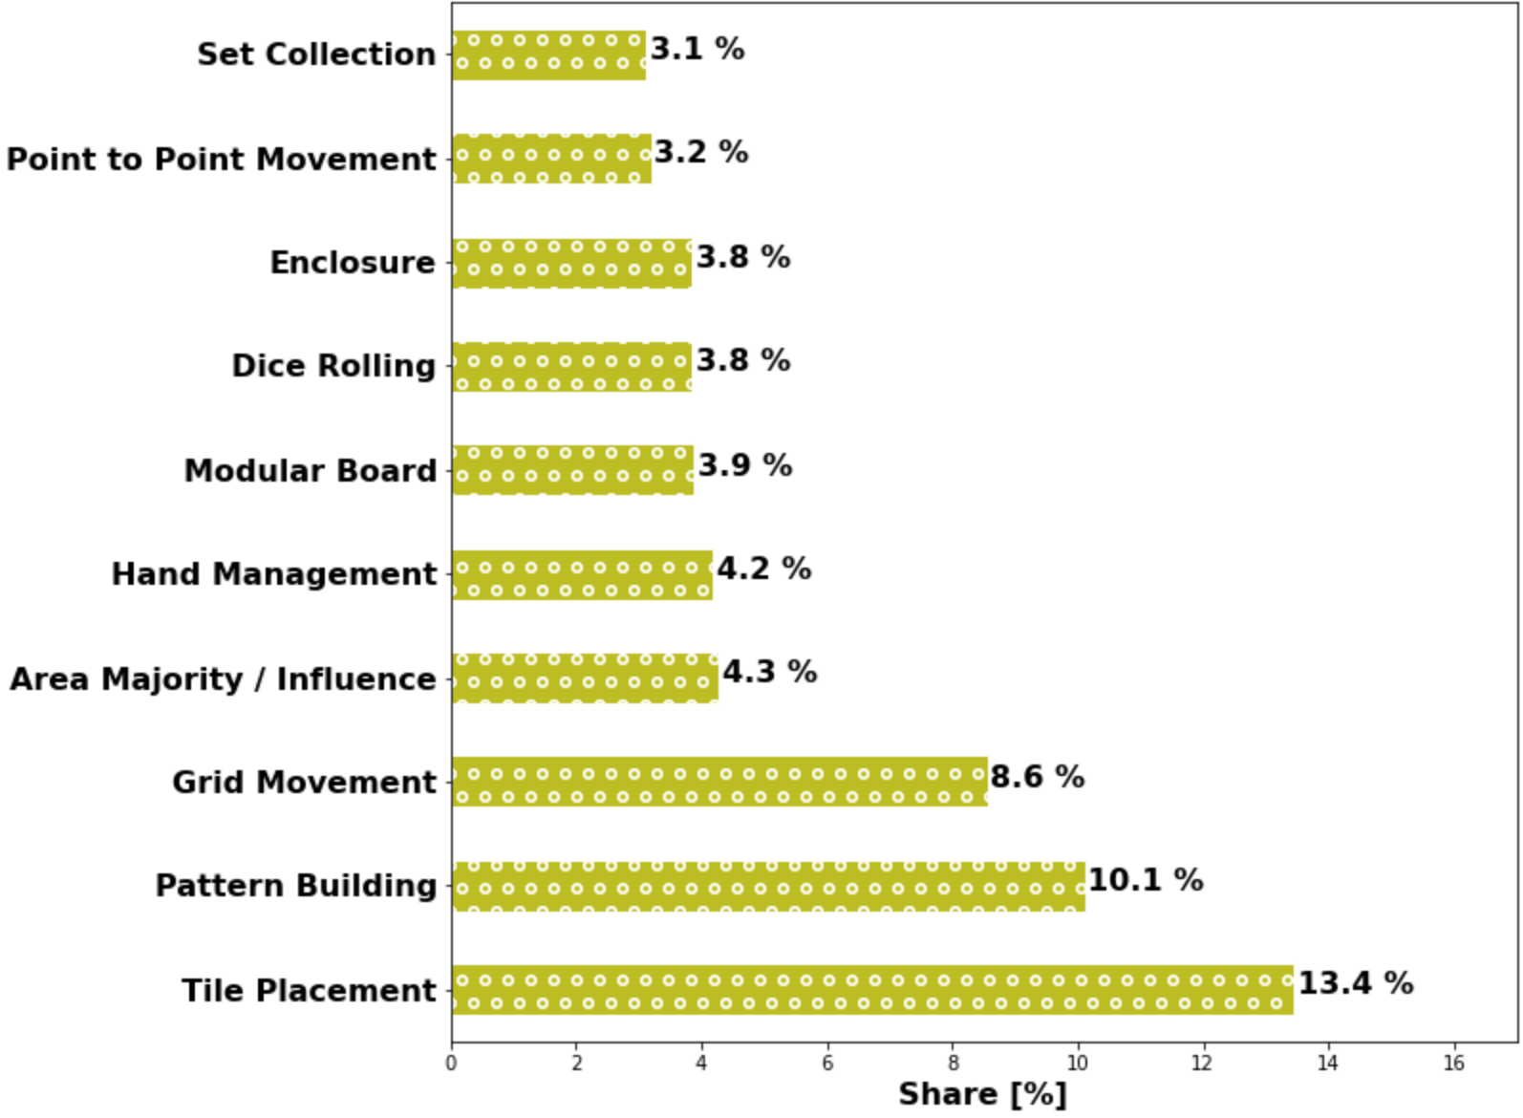
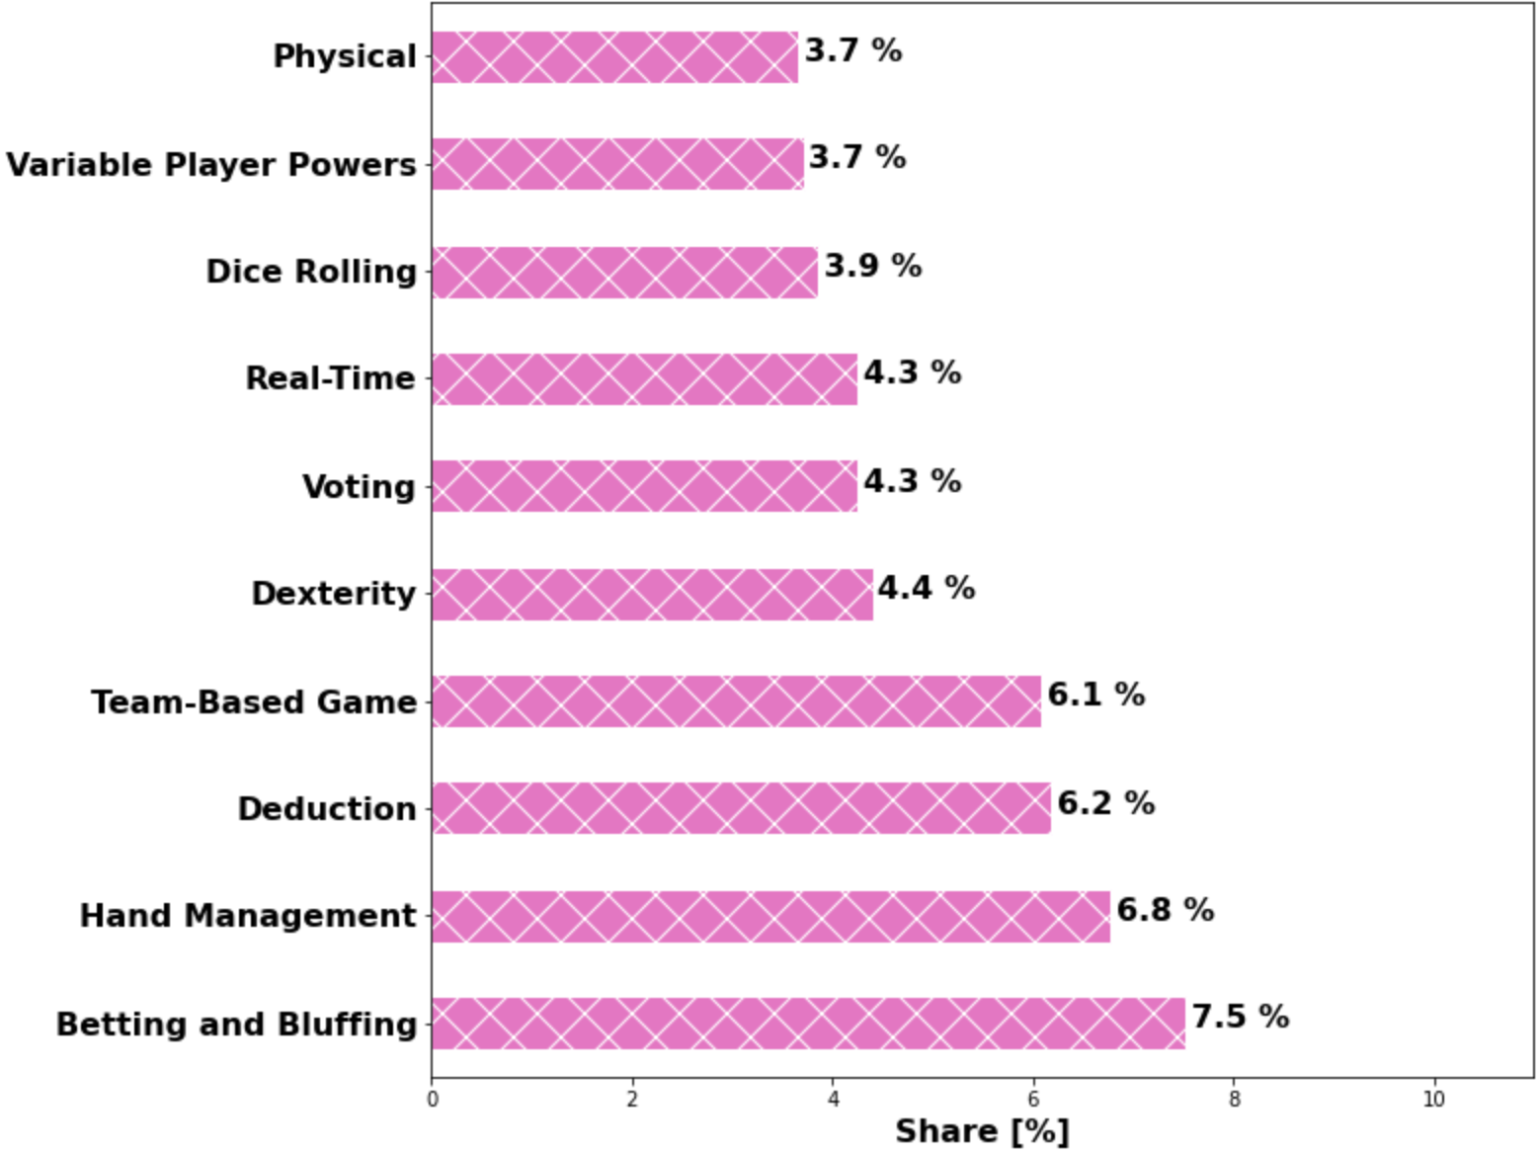
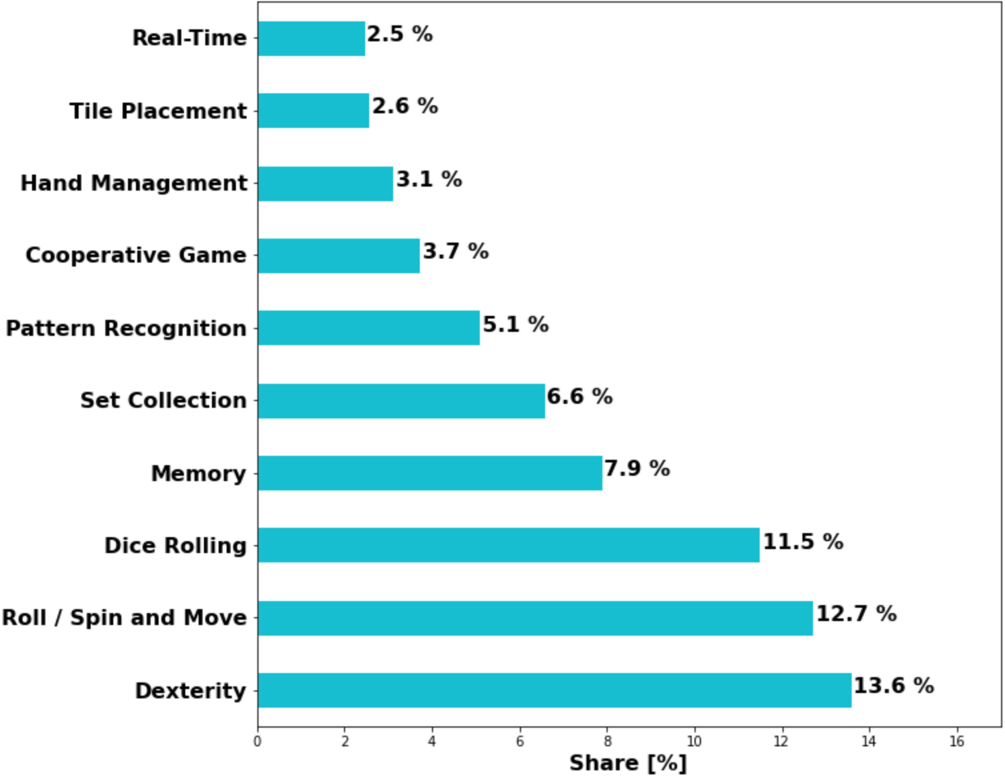




Top 10 Mechanics of Each Board Game Category
Thematic
Strategy
War
Family
Crafts, Games, and Science (CGS)
Abstract
Party
Childrens
Notes:
From the data visualization above, we learned that different board game categories have distinct top 10 board game mechanics. The board game categories include thematic, strategy, war, family, CGS, abstract, party, and childrens. However, some board game categories have top common mechanics. The top 3 most common mechanics are dice rolling (clicked), hand management (clicked), and variable player powers (clicked). Hence, if board game creators want to design a brand new board game with the most classic and most commons mechanics, they can’t go wrong with those 3 most common board game design mechanics. (34.62 seconds)
Total: 4 minute and 24.64 seconds

Slide 13

Recommendation System using
Notes:
Now, I’ll pass on to Ali to talk about the board game design recommendation system using Surprise.

Slide 14
Recommender Overview
The analysis we did is for the overall dataset, what if we wanted more in depth insight for a specific game?
We created a Recommender System with Surprise, which leverages user reviews from BGG to recommend features, to improve a specific game!
Notes:
Hi everyone, this is Ali. So the data analysis our group did was for the overall dataset. We also wanted to build a Recommender system, to give more insight on specific games.
We used the Surprise library, which is scikit-learn based framework for building and analyzing recommender systems that deals with explicit rating data.
Our model uses the Singular value decomposition++ algorithm from Surprise, which is more sophisticated model design which can also learn implicit ratings and biases of the users.
We leverage the reviews from BoardGameGeek and recommend features and mechanics to improve your specific game! I will go over case study on the next slide. [next slide plase]

Slide 15
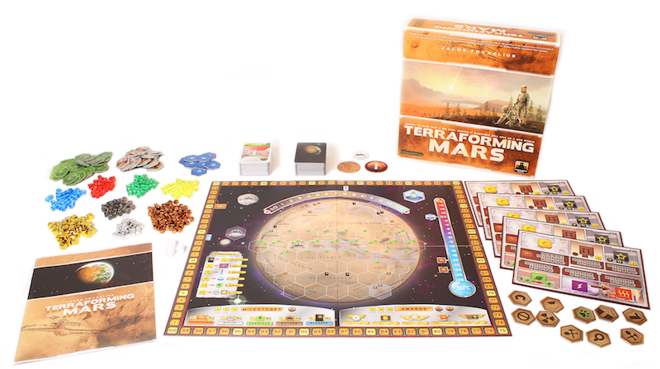
Case Study: Terraforming Mars
Find reviewers who gave average or poor rating to your game.
Then for those reviewers, find games they enjoyed within the same category as your targeted game using our Recommender Model.
Then you can do some analysis on the top rated features/mechanics, and see ways you could possibly improve your game!
Notes:
Let's say you hypothetically, you are the publisher of Terraforming Mars. Terraforming Mars is collaboratively competitive game, where the goal is to take over Mars.
You as the publisher want to increase your market share in the Strategy category by improving your game!
Our model looks for users who gave poor or average rating to your game, then finds features and mechanics those reviewers did enjoy in other games in your targeted category. You can then use those features and mechanics and try to improve on your game on the next version. [next slide please]

Slide 16
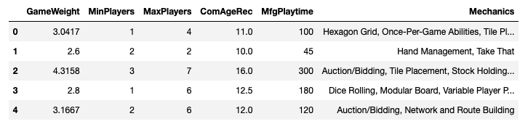
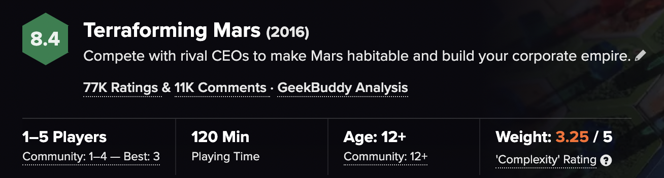
Case Study: Terraforming Mars
Notes:
The example on the top is from our model on features/mechanics to improve Terraforming Mars. The bottom image is screenshot from BoardGameGeek for the game.
To give quick overview, users enjoyed on average a longer game playtime and more auction/bidding elements. The average game weight (which is basically the complexity of game) returned was 3.18, which is very similar to current weight of Terraforming Mars 3.25. So it's most likely not necessary to change complexity of the game.
These features and mechanics returned by our model, can give you insights on how to improve your game and hopefully increase your market share! [next slide pleas]

Slide 17
Thank you and hope you find this presentation
interesting and inspiring!
—Group 1
We Value Your Feedback. Please Rate Us How We Did:
Successful Board Game Design Analysis and Recommendation System for Board Game Designers
Notes:
Thank you and hope you find this presentation interesting and inspiring!

Slide 18
Sources and References
https://www.kaggle.com/andrewmvd/board-games
https://boardgamegeek.com/
https://plotly.com/python/
https://seaborn.pydata.org/
http://surpriselib.com/
https://slidesmania.com

